Slide 1

Personal Finance Tracker App
By Hamza Zuberi

Slide 2
Overview
The Personal Finance Tracker is a cloud-based microservices application designed to help users manage and track their expenses.
The application offers secure REST API endpoints for creating, viewing, and managing expenses along with usage statistics.

Slide 3
Architecture and Features
Expense Service
Endpoints:
POST /api/v1/expenses/: Add a new expense.
GET /api/v1/expenses/: Retrieve all expenses.
GET /api/v1/expenses/{expense_id}: Fetch details of a specific expense.
DELETE /api/v1/expenses/{expense_id}: Delete an expense.
Database: SQLite for lightweight persistence.
Statistics Service
Endpoint: GET /api/v1/admin/stats/: View API usage statistics (e.g., number of requests per endpoint).
Authentication and Access Control
Role-based access control for user-level endpoints.

Slide 4
Deployment
Containerization
The application is containerized using Docker.
Each service runs in its own container.
Cloud Deployment
The services are deployed on a cloud computing platform (e.g., AWS, DigitalOcean).
Docker Compose is used for local orchestration.
Optional Advanced Deployment (Extra Credit)
Kubernetes for container orchestration over multiple nodes.

Slide 5

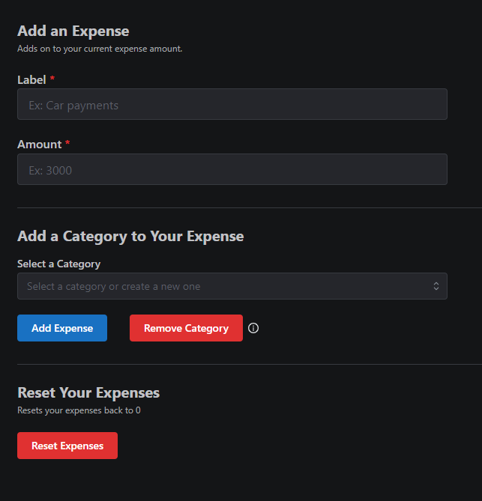
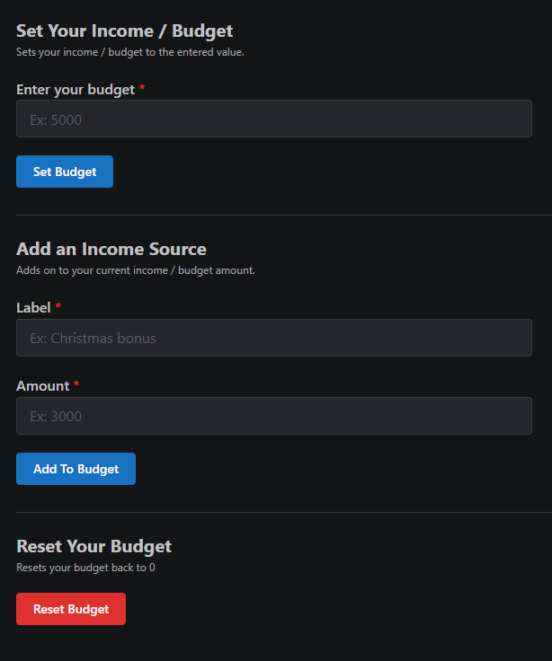
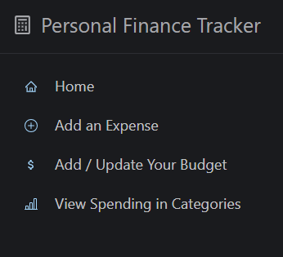
Demo

Slide 6
Example Use Cases
A user logs in and adds an expense via the POST /api/v1/expenses/ endpoint.
The expense is saved in the database, and a usage statistic entry is logged.
An admin retrieves API usage statistics via the GET /api/v1/admin/stats/ endpoint.

Slide 7
Performance Report
Response Latency Measurements:
Tested using Locust with simulated concurrent API requests.
100 requests: Average response time: 120ms.
500 requests: Average response time: 250ms.
Scalability:
Demonstrated linear scalability with container orchestration via Kubernetes.

Slide 8
Project postmortem
Challenges Faced
Setting up Kubernetes for multi-node orchestration
Ensuring security for admin endpoints
Key Learnings
Effective use of containerization and orchestration
Insights into performance testing and scalability
Future Improvements
Add more advanced ML-based analytics features
Explore serverless architecture for reduced operational overhead

